Slide 1
Open Enrollment
Health Savings Account with Benefits Debit Card

Slide 2
What is an HSA?
An HSA plan, many times referred to as a “high deductible health plan (HDHP), is health insurance that covers you and/or your family for catastrophic events.
Individuals and employers are allowed to make contributions up to the annual IRS maximum contribution amount
A health spending account owned and controlled by you, no matter where you go or who you are employed by.

Slide 3
What are the benefits of an HSA?
It Saves You Money:
All expenses are not eligible for taxes, leaving you with more spendable income
No Hassle:
Pay with a convenient debit card without the hassle of receipts
Plan for the Future:
After age 65, you can use HSA funds for non-qualifying expenses
Feel Secure:
Feel comfortable knowing you have planned for emergencies or any health trouble in the future

Slide 4
2023 Contributions and Out-of-Pocket Limits for Health Savings Accounts
 | 2023 | 2022 | Change
HSA Contribution Limit (employer + employee) | Individual: $3,850 Family: $7,750 | Individual: $3,650 Family: $7,300 | Individual: +200 Family: +450
HSA catch-up contributions (age 55 or older) | $1,000 | $1,000 | No change
HDHP minimum deductibles | Individual: $1,500 Family: $3,000 | Individual: $1,400 Family: $2,800 | Individual: +100 Family: +200
HDHP Maximum out-of-pocket amounts | Individual: $7,500 Family: $15,000 | Individual: $7,050 Family: $14,100 | Individual: +450 Family: +900

Slide 5
2023 Health Savings Accounts Contribution Limits, Deductibles and Out-of-Pocket Expenses
 | Minimum Deductible | Maximum Out-of-Pocket | Contribution Limit | 55+ Contribution
SINGLE | $1,500 | $7,500 | $3,850 | $1,000
FAMILY | $3,000 | $15,000 | $7,750 | $1,000

Slide 6
HSA Product Characteristics
Consumer Owned
Account Balance
Contributions
Distributions
Must be paired with a qualified high deductible health plan (HDHP)
May pair with Limited Purpose FSA and/or HRA
Vision, dental expenses only
Employer and/or consumer may contribute to account
Contributions made by payroll deduction, check, transfer
IRS restrictions on annual contribution amount
No third party substantiation required – consumer responsible
Internal Revenue Code §213(d) expenses may be reimbursed
Funds may be withdrawn for non-qualified expenses with penalty
Funds may carry over year to year
Funds are portable
Funds may be invested and earn interest for greater savings potential

Slide 7
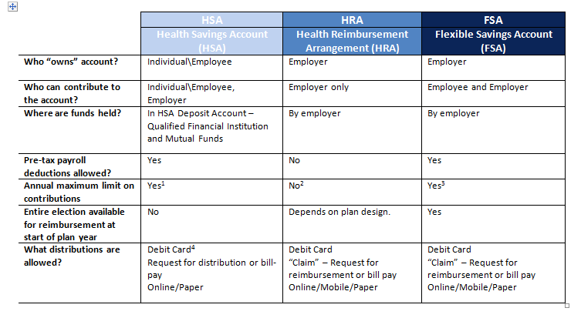
CDH Plan Comparisons
Account Characteristics
 | HSA | HRA | FSA
Who owns the account? | Consumer | Employer | Employer
Who contributes to the account? | Consumer and/or employer | Employer | Consumer and/or employer
What amount can be contributed? | The IRS establishes the annual allowable amount and indexes this amount for inflation. | There are no restrictions. | Currently, no restrictions. Beginning 1/1/13, limited to $2,500 per covered employee.
How are contributions made? | Through payroll deduction, check, or transfer. | Through payroll deduction. | Through payroll deduction.
Can funds in the account carry over from year to year? | Yes. | Depends on plan design opted by employer. | No.
Are funds portable in the event of job change or death? | Yes. | No. Funds are forfeited. | No. Funds are forfeited.
Do funds accrue interest? | Yes, interest can accrue. | No. Interest does not accrue. | No. Interest does not accrue.
Can funds be invested? | Yes. Funds can be invested. | No. | No.
Is third party substantiation of expenses required? | No. Consumer is responsible for substantiating the use of funds. | Yes. Each claim or transaction must be substantiated. | Yes. Each claim or transaction must be substantiated.
Is the annual amount of the contribution available on the first day of coverage? | No. Funds are available after they are contributed. | Depends on the employer’s choice for funding the plan | Yes.
What expenses can be reimbursed? | All IRS-defined medical expenses | All or a subset of IRS-defined medical expenses | All IRS-defined medical expenses
Can funds be withdrawn for non-medical expenses? | Yes, but these funds are subject to an additional 20% tax penalty, except when an individual is 65 or older, disabled or died during the year. | No. | No.

Slide 8
CDH Demonstrated Cost Savings
CIGNA Study
First-year savings of 12% compared to traditional plans
Five-year estimated savings of $7,900
Assumes $11,000 average base premium year one
Assumes 12% savings year one, 9% thereafter
Source: Healthcare Trends Institute

Slide 9
What Expenses Can Be Reimbursed Through a Healthcare HSA?
Most medical expenses are HSA eligible, such as:
Office Visit Copays
Prescription Drug Copays
Dental Treatment
Vision care, eyeglasses, and contact lenses
Eye Operations
Over-the-counter medications
Other unreimbursed health and dental expenses

Slide 10
How do I get started?
Easy to open – talk to your HR representative about enrolling in an HSA
Easy to use – with your debit card, paying for your medical expenses is easy.
Easy to contribute – talk to your employer about your contribution amounts and make a personal plan of the amounts you wish to contribute
Easy to access – with account access and mobile capability, checking your contribution balance is simple.

Slide 11
The Card Makes
HSAs Easier
Easy – a simple swipe of the Card makes it hassle free!
Automatic – funds are immediately deducted from your FSA at the time you incur the expense.
Convenient – there are no manual claim forms to submit.
Simple to track – your current balance is available 24/7 at the web site listed on the back of your Card.

Slide 12
Action Items:
Plan for next year.
Sign up today.
Save your receipts.
Open Enrollment Period
(personalized per employer)

Slide 13
Questions? For more information, contact your HR representative.

